Slide 1

Call Center Simulation using Simpy
Data 604 Final Project
Erinda Budo

Slide 2
Problem Statement
1.How has Covid 19 impacted bank call centers services?
2.Can automated services help in reducing waiting time to speak to a representative?

Slide 3





Description of problem
After the average of two minutes hold customers prefer to hang up the call and approximately half of them don’t call back, it affects the loyalty of customer towards a business. In today’s technology-driven world, information is available rapidly, so when circumstances get out of bed in which information is slow to right to use or confusing, the customer experience is weakened.
Long wait on hold or getting information can make a customer irritating. The longer they are on hold, the more frustration physiques up and engagement is reduced before an agent even handles the call. Add in poor call course-plotting, confusing IVRs, and agent turnover, and good service calls quickly go, leaving your customers frustrated and your business in Hazard.
In this project I will simulate a bank call center that provides services through:
-Automated customer services
-Representative

Slide 4
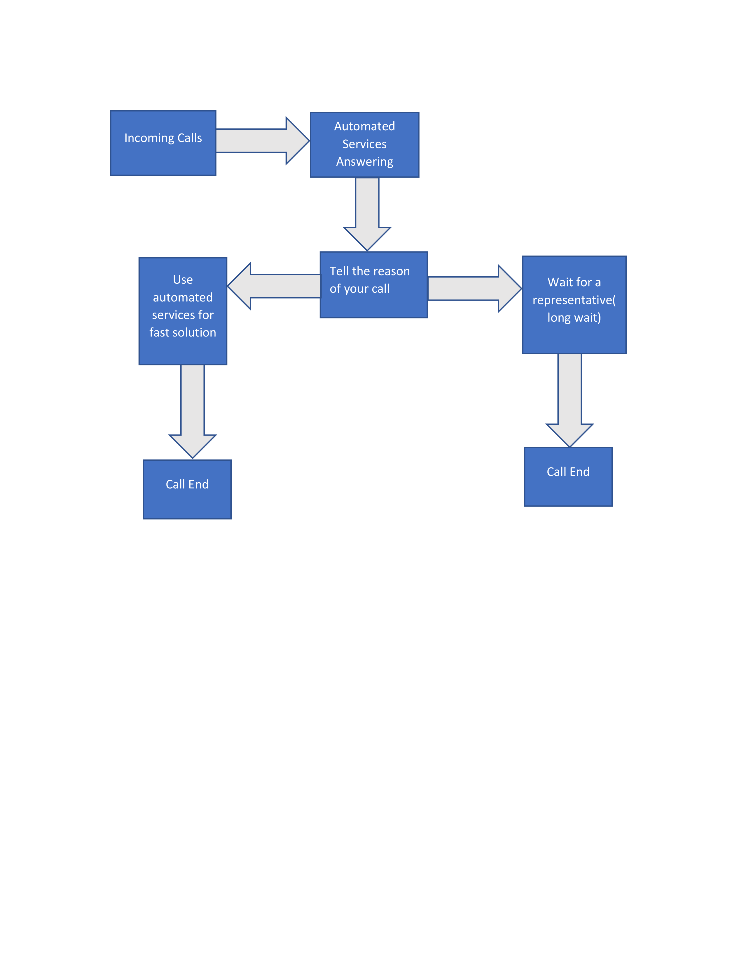
Flowchart

Slide 5
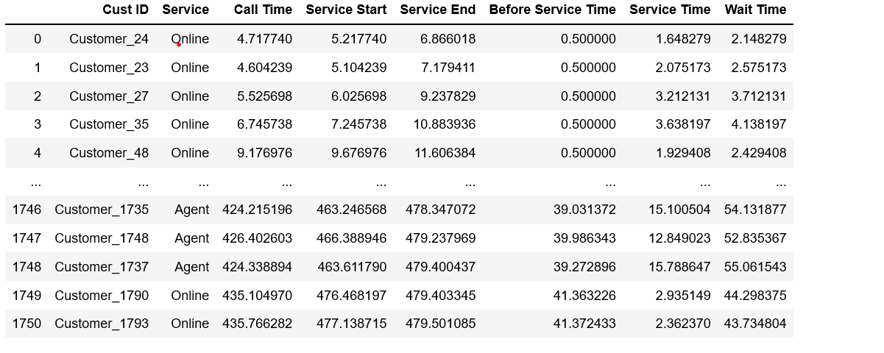
Simulation results for each customer

Slide 6
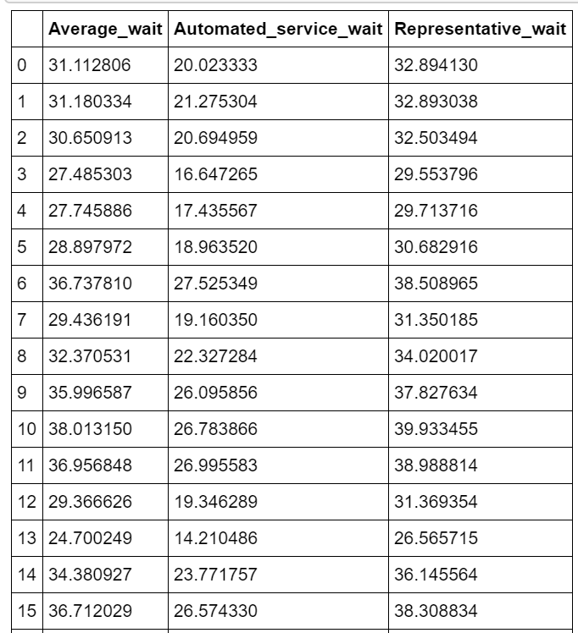
Waiting time to speak with a representative or use the automated services

Slide 7
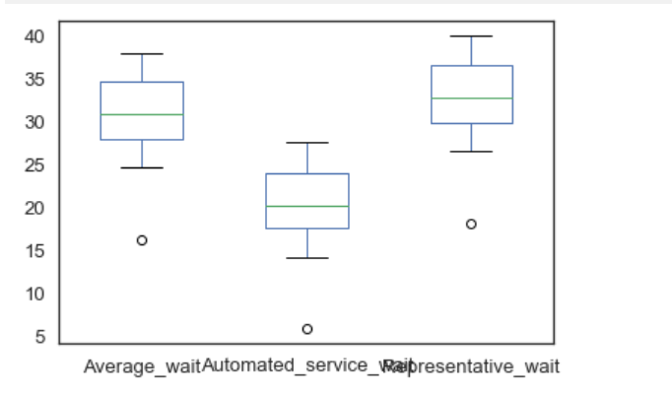
The maximum waiting time is to speak to an agent and using automated services reduces the waiting.

Slide 8

CONCLUSION
The covid has a huge impact on waiting times for bank customers .customers ARE wasting time waiting no matter if they choose automated services or speaking directly with a representative. The reason why the waiting time for using automated services may be because AI cannot answer all human questions and they waste time finding the right option which might be helpful. If more representatives would be available then the waiting time would be less for sure and the customers much happier.
.

